Slide 1
Case Study
Simple Cipher
Advanced Cipher
Baptista Method

Slide 2
Simple Cipher
Proposed by Roskin and Casper.
It is a Block cipher based on unpredictability of logistic map.
Symmetric Key Encryption Algorithm.

Slide 3
Simple Cipher
Keys
Array of 50 randomly generated numbers
Initial condition
Parameter of the logistic map

Slide 4
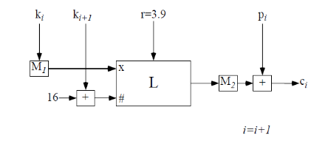
Simple Cipher – Block Diagram
Encryption
Keys mapped from [0, 256] to range [0, 1]
The key is iterated in Block L
Output mapped from [0, 1] to [0, 256]
Final output added to plain text
Decryption
Given the keys and cipher text, receiver can completely determine the message.

Slide 5

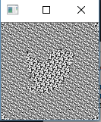
Simple Cipher – Test Case
Input Image
Encrypted Image

Slide 6

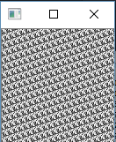
Simple Cipher – Test case
Input Image
Encrypted Image

Slide 7
Advanced Cipher
Proposed by Roskin and Casper.
Extended version of simple cipher with a feedback to reduce the periodicity in the cipher text.

Slide 8
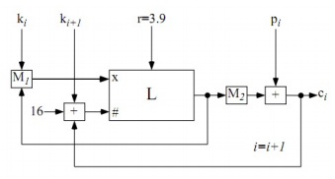
Advanced Cipher – Block Diagram
Encryption
Similar to simple cipher but with a additional feedback in the initial value and the number of iteration
Decryption
Similar to simple cipher

Slide 9
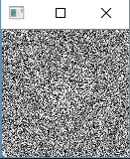
Advanced Cipher – Test Case
Input Image
Encrypted Image

Slide 10

Advanced Cipher – Test Case
Input Image
Encrypted Image

Slide 11
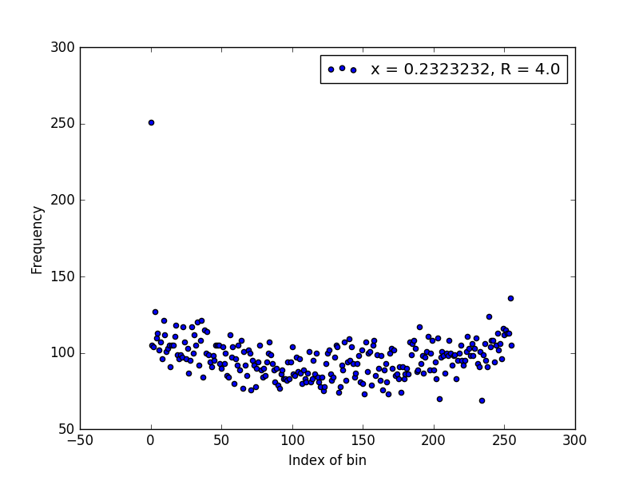
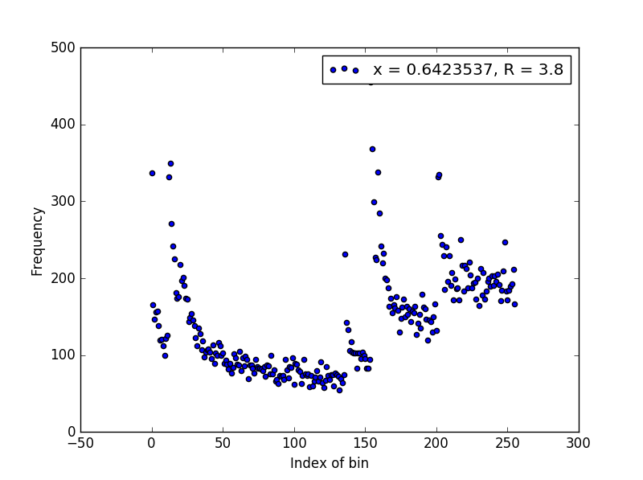
Baptista Method – Logistic Map

Slide 12
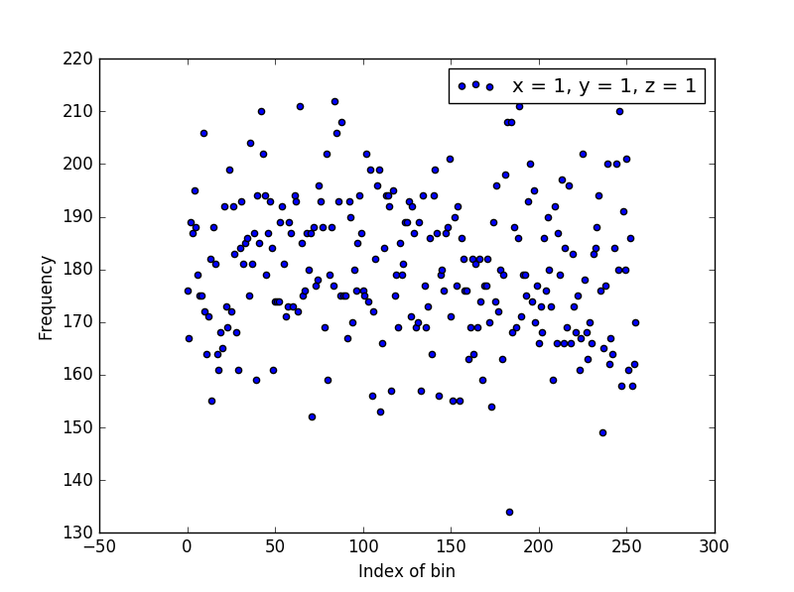
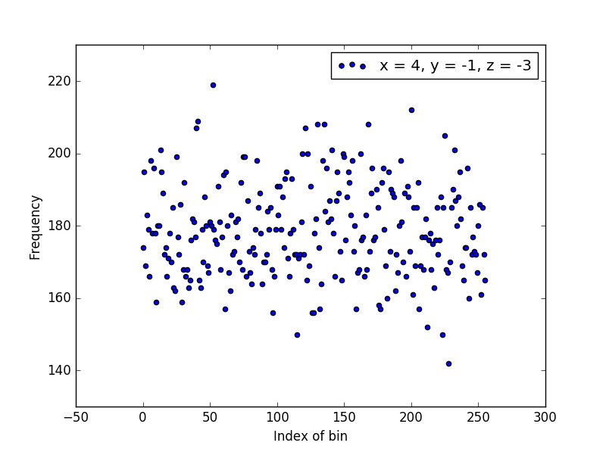
Baptista Method – Lorenz System

Slide 13
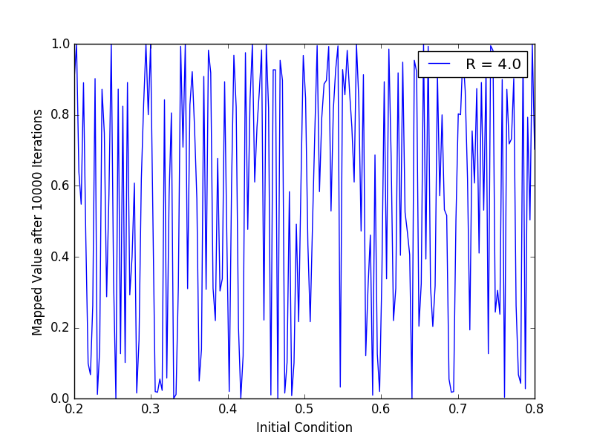
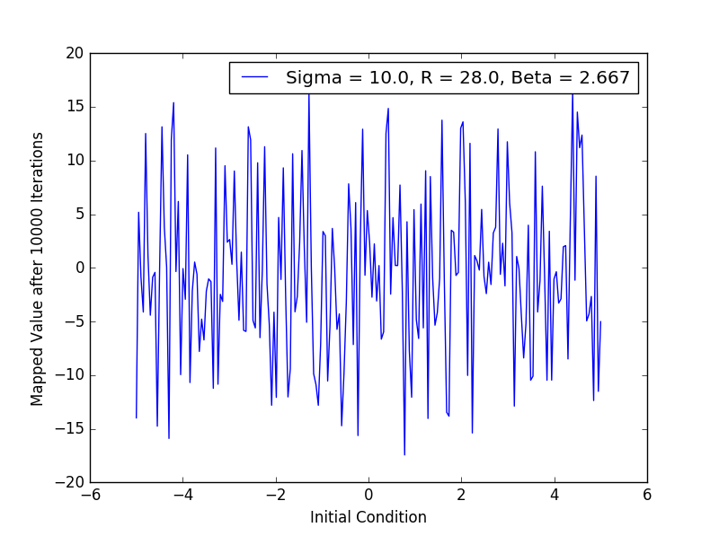
Baptista Method
Logistic Map
Lorenz System

Slide 14
Baptista Method
It is a block cipher.
Symmetric Key cipher.

Slide 15
Baptista Method
Keys
Using Logistic Map
Initial value or the seed of the map
Parameter of logistic map
Using Lorenz System
Initial value or the seed of the map
Parameter of Lorenz System
Variable which is used for encryption i.e. X or Y or Z
Bound of the phase space used

Slide 16
Baptista Method
Encryption
Phase Space is divided into 256 bins.
Bin index is the value for the particular pixel / plaintext.
Cipher text = Number of iterations to reach a bins
Decryption
The receiver has both the cipher text and the key.
The receiver can determine the plain text using the number of iteration.

Slide 17

Baptista Method – Test Case (Logistic Map)
Input Image
Encrypted Image

Slide 18

Baptista Method – Test Case (Lorenz System)
Input Image
Encrypted Image

